Slide 1

NASI SPONSORZY I PARTNERZY

Slide 2
Zarządzanie zasobami SQL Server
Łukasz Grala

Slide 3



Łukasz Grala
Architekt i trener - Data Platform & Business Intelligence Solutions
Prelegent i ekspert na licznych konferencjach
Wykładowca i autor publikacji
Posiada liczne certyfikaty (MCSE, MCITP, MCSA, MCT)
Od 2010 roku wyróżniony nagrodą MVP w kategorii SQL Server
Lider PLSSUG (Poznań)
lukasz@sqlexpert.pl lukasz@grala.biz

Slide 4
Resource Governor goals
Ability to differentiate workloads
Ability to monitor resource usage per group
Limit controls to enable throttled execution or prevent/minimize probability of “run-aways”
Prioritize workloads
Provide predictable execution of workloads
Specify resource boundaries between workloads
Notes:
In order to leverage Resource Governor you need to be differentiate workloads on the same SQL instance. If workloads can not be differentiated then you probably should not implement resource governor.
Once workloads can be differentiated, resource governor can be used to prevent one workload from monopolizing resources within a SQL Server instance. The workload can also be prioritized.

Slide 5
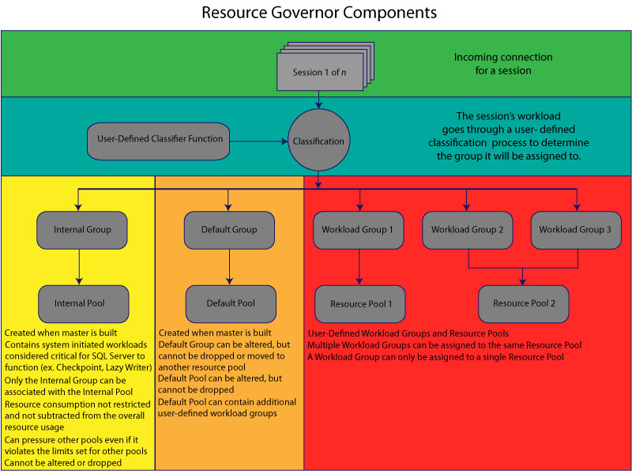
Resource Governor components

Slide 6
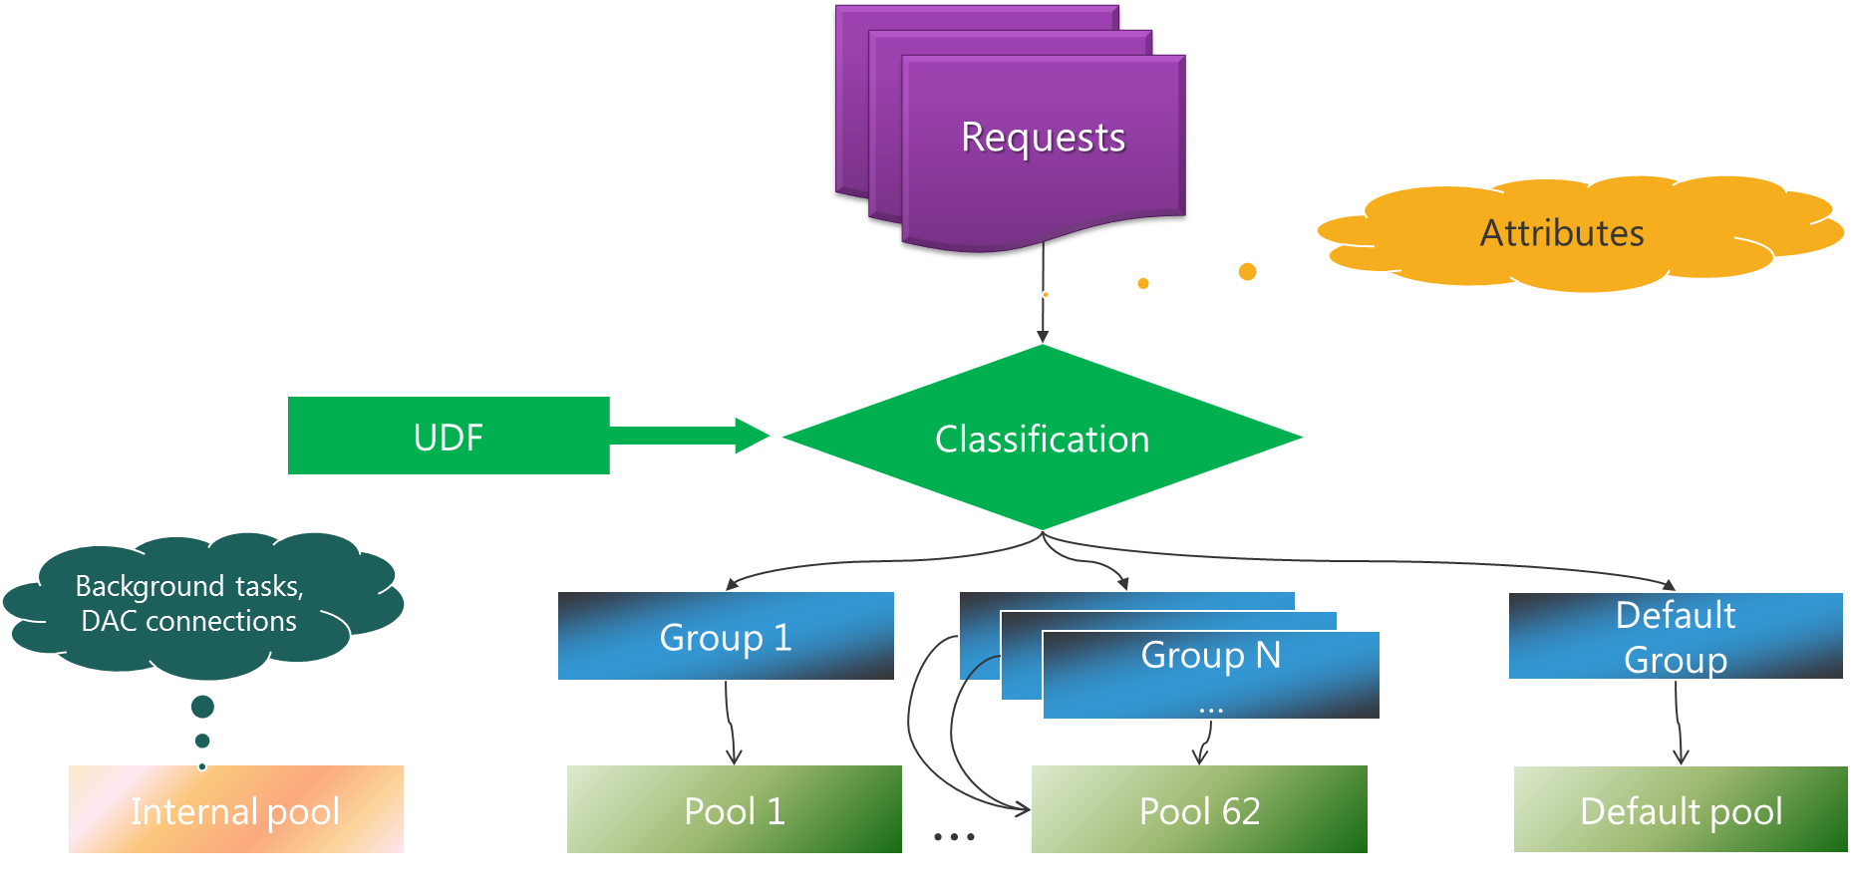
Resource Governer components

Slide 7
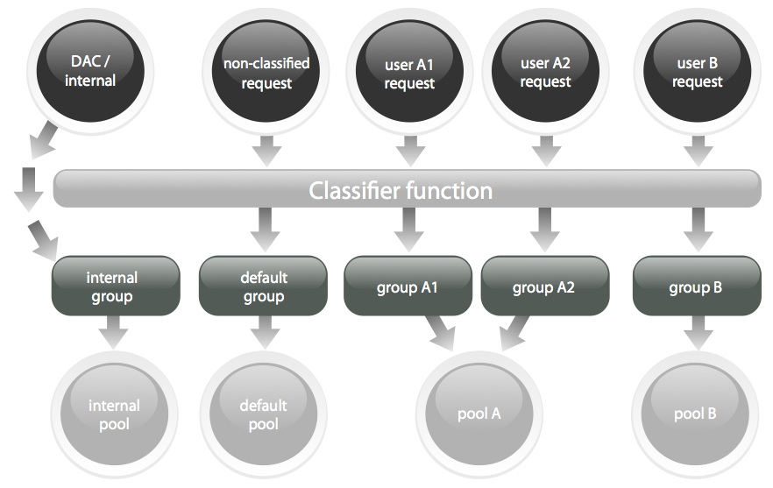
Resource Governer - paths

Slide 8
Complete resource governance
What’s being delivered
Add max/min IOPS per volume to Resource Governor pools
Add DMVs and perfcounters for IO statistics per pool per volume
Update SSMS Intellisense for new T-SQL
Update SMO and DOM for new T-SQL and objects
Main benefits
Better isolation (CPU, memory, and IO) for multitenant workloads
Guarantee performance in private cloud and hosters scenario

Slide 9
Resource pools
Represents physical resources of server
Can have one or more workloads assigned to pool
Pool divided into shared and non-shared
Pools control min/max for CPU/memory and now IOPS
CREATE RESOURCE POOL pool_name
[ WITH
( [ MIN_CPU_PERCENT = value ]
[ [ , ] MAX_CPU_PERCENT = value ]
[ [ , ] CAP_CPU_PERCENT = value ]
[ [ , ] AFFINITY {SCHEDULER = AUTO | (Scheduler_range_spec) | NUMANODE = (NUMA_node_range_spec)} ]
[ [ , ] MIN_MEMORY_PERCENT = value ]
[ [ , ] MAX_MEMORY_PERCENT = value ]
[ [ , ] MIN_IOPS_PER_VOLUME = value ]
[ [ , ] MAX_IOPS_PER_VOLUME = value ])
]

Slide 10
Resource pools
Minimums across all resource pools can not exceed 100 percent
Non-shared portion provides minimums
Shared portion provides maximums
Pools can define min/max for CPU/Memory/IOPS
Mins defined non-shared
Max defined shared

Slide 11
Steps to implement Resource Governor
Create workload groups
Create function to classify requests into workload group
Register the classification function in the previous step with the Resource Governor
Enable Resource Governor
Monitor resource consumption for each workload group
Use monitor to establish pools
Assign workload group to pool
Notes:
Create additional and/or alter existing resource pools with the appropriate settings. As mentioned previously, you cannot alter the Internal Pool. You can alter the Default Pool.
Create additional and/or alter existing workload group(s) with the appropriate settings and assign each workload group to a specific resource pool. As mentioned earlier, you cannot alter the internal workload group. You can alter the default group. You cannot m ove the default group to another resource pool.
Create/alter a user-defined function to perform the classification (ie. A function returning the name of the workload group each session will be assigned to based on some connection info such as login name or application name). Note: This UDF is also referred as the “classifier function” when configuring the Resource Governor.
Register the classification function with Resource Governor.
Start the Resource Governor and apply all the changes by running:
ALTER RESOURCE GOVERNOR RECONFIGURE
You can clear the Resource Governor Statistics using the following command:
ALTER RESOURCE GOVERNOR Reset Statistics
You can unregister the classifier function in two ways:
ALTER RESOURCE GOVERNOR DISABLE
OR
ALTER RESOURCE GOVERNOR WITH (Classifier_Function = NULL);
ALTER RESOURCE GOVERNOR RECONFIGURE

Slide 12
Resource Governor scenarios
Scenario 1: I just got a new version of SQL Server and would like to make use of resource governor. How can I use it in my environment?
Scenario 2 (based on Scenario 1): Based on monitoring results I would like to see an event any time a query in the ad-hoc group (groupAdhoc) runs longer than 30 seconds.
Scenario 3 (based on Scenario 2): I want to further restrict the ad-hoc group so it does not exceed 50 percent of CPU usage when all requests are cumulated.
Notes:
Scenario 1
BEGIN TRAN
-- create groups with all default settings
CREATE WORKLOAD GROUP groupAdhoc
CREATE WORKLOAD GROUP groupReports
CREATE WORKLOAD GROUP groupAdmin
-- create classification function
-- note that anything that does not get classified goes into 'Default' group
CREATE FUNCTION rgclassifier_v1() RETURNS SYSNAME
WITH SCHEMABINDING
AS
BEGIN
IF (SUSER_NAME() = 'sa')
RETURN 'groupAdmin'
IF (APP_NAME() LIKE '%MANAGEMENT STUDIO%') OR
(APP_NAME() LIKE '%QUERY ANALYZER%')
RETURN 'groupAdhoc'
IF (APP_NAME() LIKE '%REPORT SERVER%')
RETURN 'groupReports'
END
-- register the function with RG
ALTER RESOURCE GOVERNOR SET CLASSIFIER FUNCTION TO dbo.rgclassifier_v1
GO
COMMIT TRAN
GO
-- enable RG with new configuration
ALTER RESOURCE GOVERNOR ENABLE
GO
Scenario 2
-- alter the policy to specify the limit on CPU
-- an event will be generated when the limit is reached
ALTER WORKLOAD GROUP groupAdhoc
SET (REQUEST_MAX_CPU_TIME_MS = 30000)
GO
-- notify the resource governor about the changes
ALTER RESOURCE GOVERNOR RECONFIGURE
GO
Scenario 3
BEGIN TRAN
-- create new pool and set max CPU on it
CREATE RESOURCE POOL poolAdhoc
SET (MAX_CPU_PERCENT = 50)
-- move adhoc group to use the newly created pool
ALTER WORKLOAD GROUP groupAdhoc
USING poolAdhoc
GO
COMMIT TRAN
GO
-- notify the resource governor about the changes
ALTER RESOURCE GOVERNOR RECONFIGURE
GO

Slide 13
Monitoring Resource Governor
System views
sys.resource_governor_resource_pools
sys.resource_governor_configuration
DMVs
sys.dm_resource_governor_resource_pools
sys.dm_resource_governor_resource_pool_volumes
sys.dm_resource_governor_configuration
New performance counters
SQL Server:Resource Pool Stats
SQL Server:Workload group
XEvents
file_read_enqueued
file_write_enqueued

Slide 14
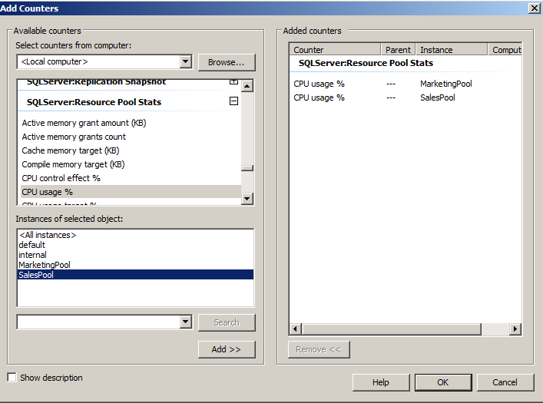
Monitoring
SQLServer:Resource Pool Stats->CPU usage

Slide 15
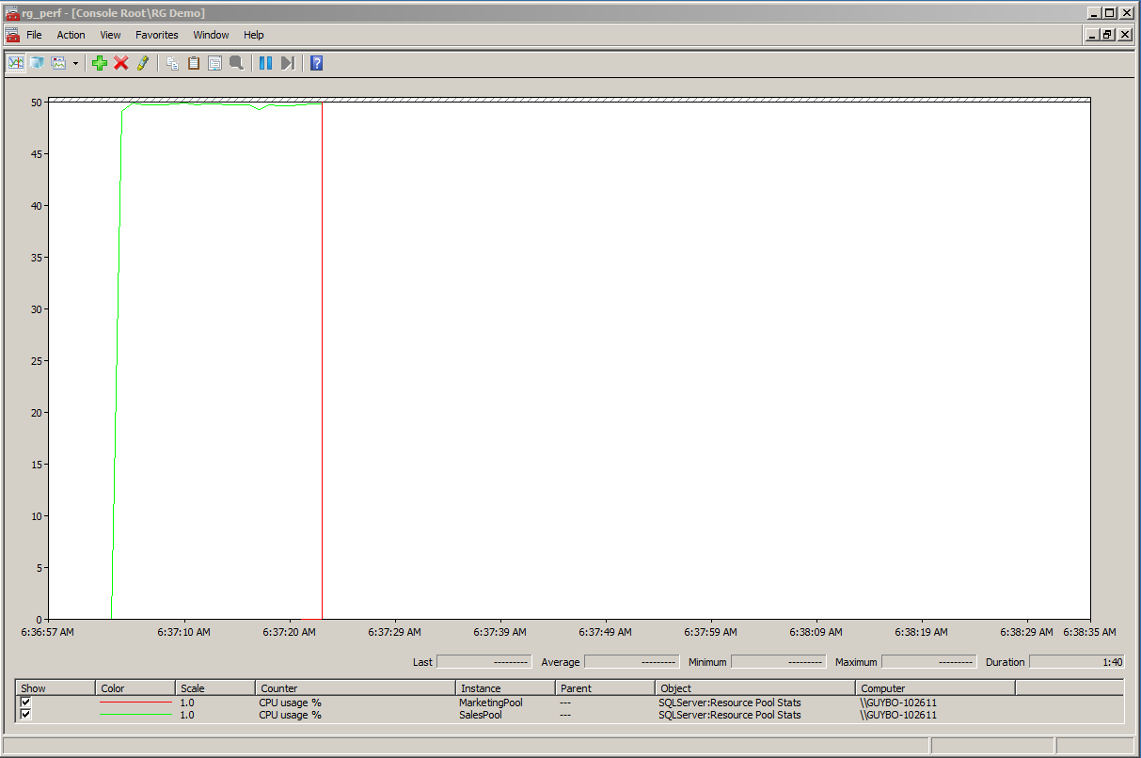
Monitoring
SQLServer:Resource Pool Stats->CPU usage

Slide 16
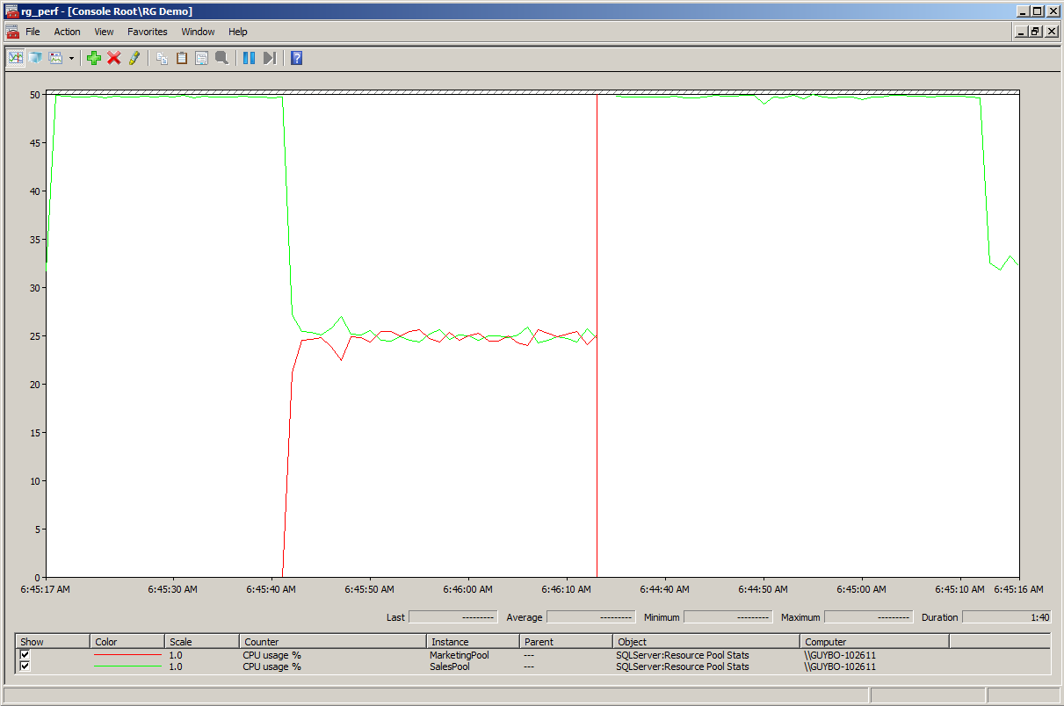
Monitoring
SQLServer:Resource Pool Stats->CPU usage

Slide 17
Best practices
Test the Dedicated Administrator Connection – Then Test It Again
Optimize the Classifier Function
Do Not Let the Classifier Function Trust Everything
Use Memory Constraints with Caution
Maintain Similar Test and Development Servers
Always Be Monitoring, Evaluating, and Adapting

Slide 18

Questions ?

Slide 19

NASI SPONSORZY I PARTNERZY
Organizacja: Polskie Stowarzyszenie Użytkowników SQL Server - PLSSUG

